Slide 1
We’ll start at 6:10 (U of T time!)

Slide 2
Sampling and Data Visualization
Course Intro
Data Sciences Institute, University of Toronto

Slide 3
I wish to acknowledge this land on which the University of Toronto operates. For thousands of years it has been the traditional land of the Huron-Wendat, the Seneca, and the Mississaugas of the Credit. Today, this meeting place is still the home to many Indigenous people from across Turtle Island and we are grateful to have the opportunity to work on this land.

Slide 4


Slide 5


Slide 6
We will...
Explain the structure of this course
Go through an overview of what to expect in the rest of this course (high-level)
Sampling Intro!

Slide 7
Why are we here?

Slide 8
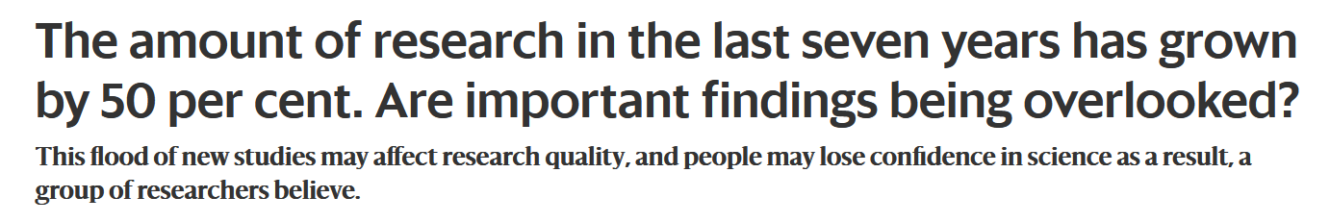
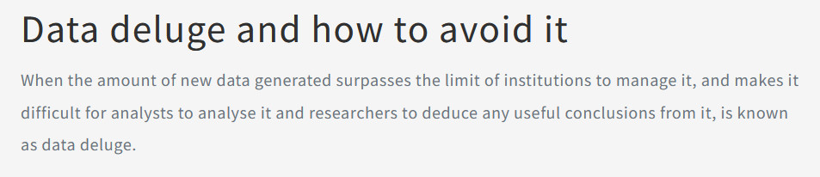
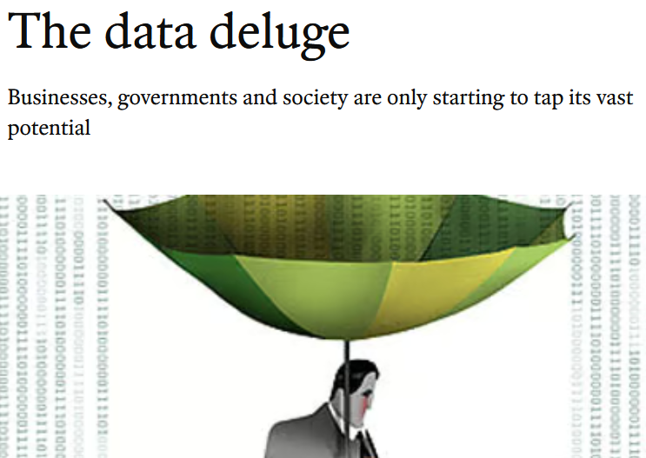
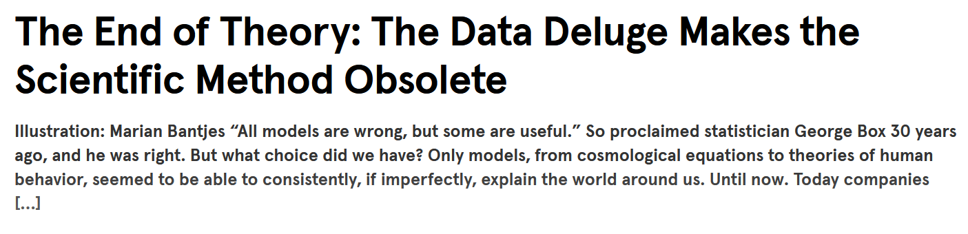
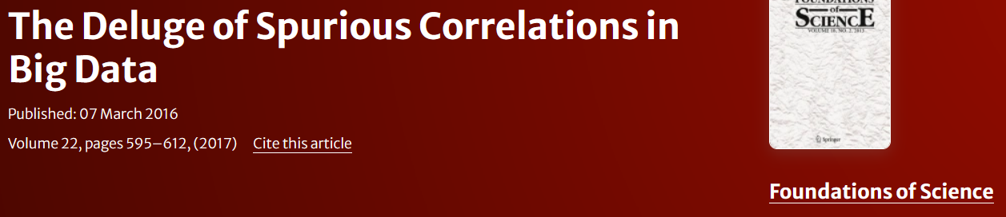

Slide 9
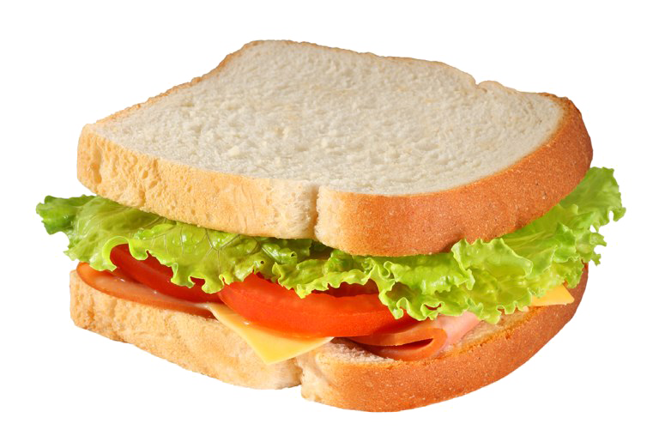
Study Design
What comes before and after writing our code to analyze our data in Python?
Where do we get the data?
How do we get the data?
Why are we collecting data in specific ways and quantities?
How do we communicate our results?
Who are our results for?

Slide 10
Case Study: Why does sampling matter?

Slide 11
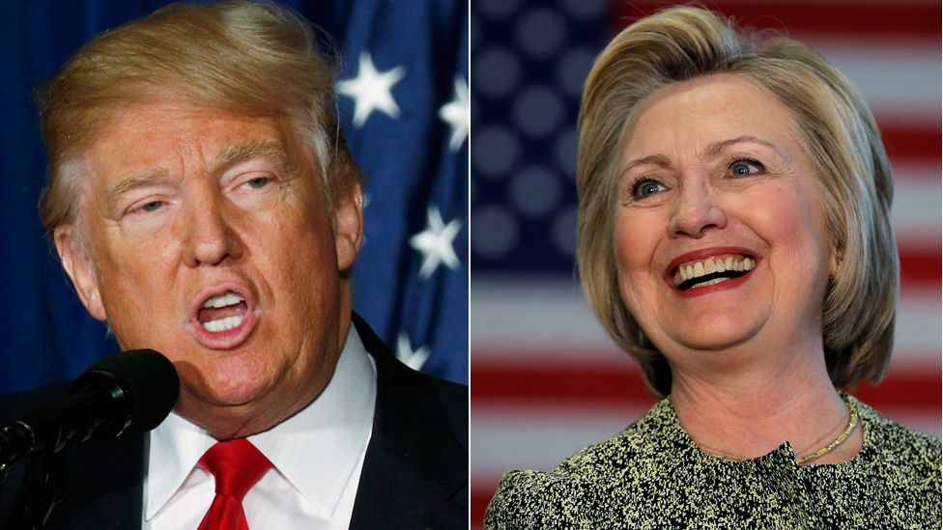

Slide 12
2016 US Presidential Election
Donald Trump (Republican Nominee) vs. Hilary Clinton (Democratic Nominee)
Polarization!
Strongly negative campaigning from both parties
“Of nearly 70,000 political television ads that ran in recent days, less than one in 10 were primarily positive, a CNN analysis of data from Kantar Media/CMAG shows.”

Slide 13
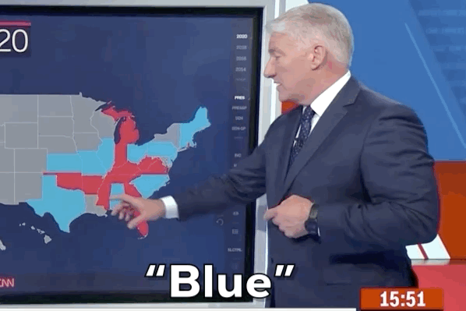
Election Predictions
Statisticians and newsrooms use data to predict which candidate will become president
These data are largely from pre-vote surveys and interviews with prospective voters, with some projection based on historical trends (e.g. an area has always voted Democrat)

Slide 14
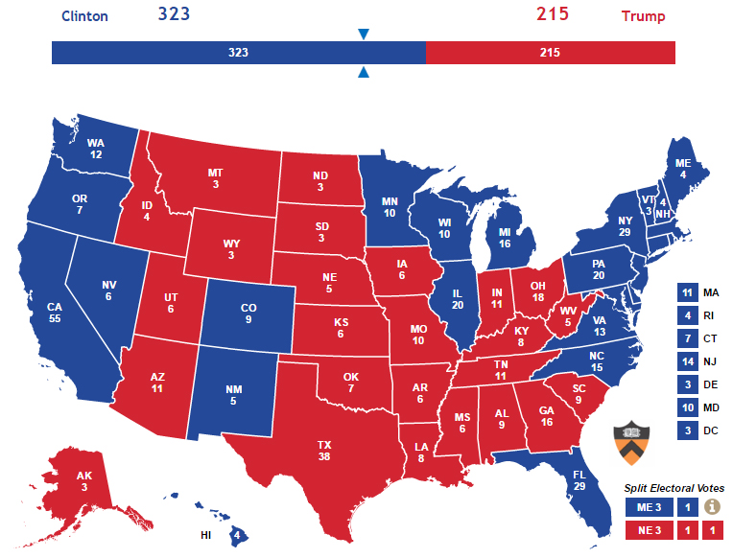

Slide 15

Election Results
Trump overperformed expectations, winning the electoral college, and was elected President
The predictions were wrong! Almost all of them!
But why?
What do you think are some potential reasons that the predictions about the 2016 US Presidential election were so wrong?

Slide 16
Where does sampling come in?
Timing
Medium
Dishonest responses
Nonresponse bias
Non-representative sampling
In a well-designed survey, we need to consider how each of these factors may impact our conclusions.

Slide 17
The Basics (Terminology)

Slide 18
“Sampling consists of selecting some part of a population to observe so that one may estimate something about the whole population.” Thompson, ‘Sampling: Third Edition’ (2012)

Slide 19
What is a population?
Population
Real or hypothetical set of units with characteristics of attributes that can be modeled by random variables
Can be infinite or finite
Inclusion and exclusion criteria must be clearly defined

Slide 20
Population levels
Target population = all units covered by our study objective
Frame population = all units covered by our sampling frame (the parts of our population we take our sample from)
Sampled population = what we actually collected responses from

Slide 21
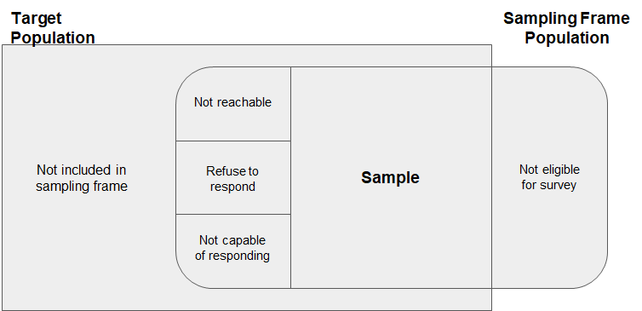

Slide 22
Why sampling?
Sampling lets us collect data about individuals (sampling units) from only a subset of our target population, called our sample, and make inferences about the whole population
This is more cost- and time-efficient than sampling an entire population; usually easier and more realistic
How do we collect samples?

Slide 23
Surveys
“A survey is an investigation about the characteristics of a given population by means of collecting data from a sample of that population and estimating their characteristics through the systematic use of statistical methodology.” (OECD)

Slide 24
Surveys
“The term survey covers any activity that collects or acquires statistical data. Included are censuses, sample surveys, the collection of data from administrative records and derived statistical activities” (Statistics Canada)

Slide 25
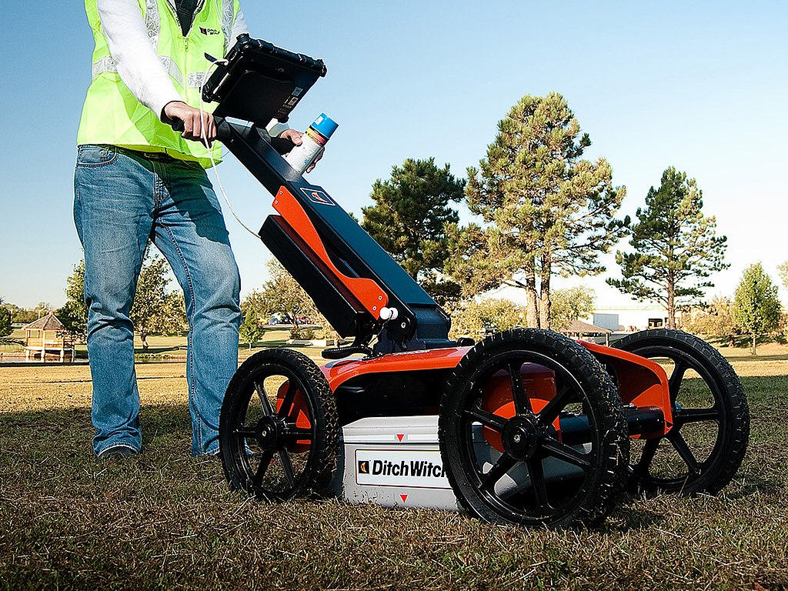
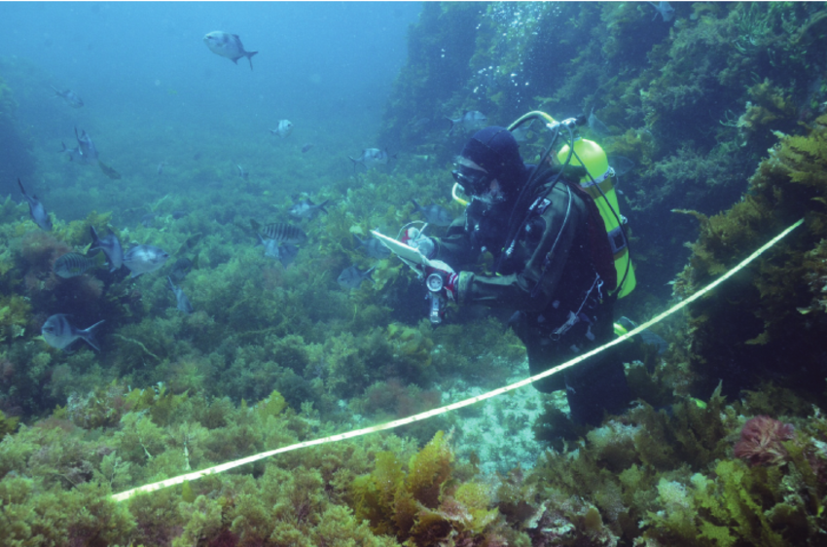
Surveys

Slide 26
Activity: Exploring Samples (Together)
A pilot survey for The Canadian Longitudinal Study on Aging (CLSA) was conducted in the province of Ontario. The survey intended to cover the general population of the province with age 45–80 (inclusive). Survey questionnaires were sent to randomly selected individuals through regular mail. Individuals and their mailing addresses were selected and obtained from the Provincial Health Records.
What are the target population, sampling units, frame population, and sampled population?

Slide 27
Activity: Exploring Samples (Try it!)
A teacher wanted to find the average number of hours each week spent on watching TV by 4 and 5 year old children in Waterloo. She conducted a survey using the list of 123 kindergartens administered by the Waterloo Region District School Board. She first randomly selected ten kindergartens from the list. Within each kindergarten, she was able to obtain a complete list of all 4 and 5 year old children, with contact information for their guardians. She then randomly selected 50 children from the list and mailed the survey to their guardians. The sample data were compiled from completed and returned surveys.
What are the target population, sampling units, frame population, and sampled population?

Slide 28
What will we cover in this course?

Slide 29
Coming Up…
Probability 101
Populations and Samples
Types of Samples
Simple Random Samples, Stratified Samples, Cluster Samples, Resampling
Errors in Sampling
Survey Quality and Design
Sampling Ethics and Privacy

Slide 30
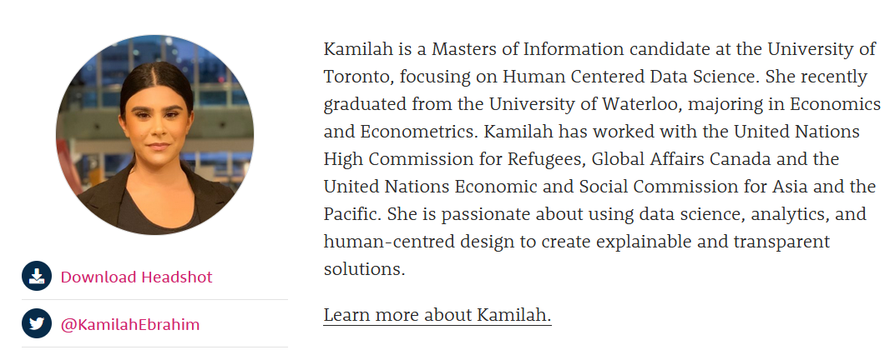
Guest Speaker

Slide 31
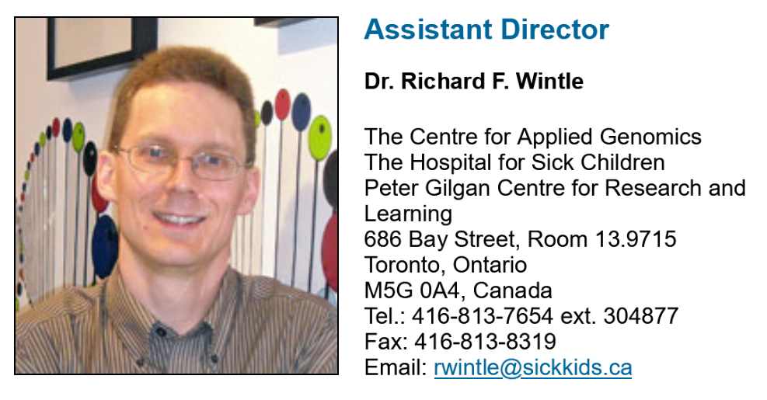
Guest Speaker

Slide 32

Assignments

Slide 33
Submitting your work!
Google folders?
Google forms!

Slide 34
Learning Outcomes
Develop ability to implement simple probability samples.
Understand more complicated sampling procedures and the tradeoffs involved.
Identify and understand sources of error or inaccuracies in data as a result of sampling strategies.
Develop intuition around survey quality.

Slide 35
Learning Outcomes
Develop ability to implement simple probability samples.
Understand more complicated sampling procedures and the tradeoffs involved.
Identify and understand sources of error or inaccuracies in data as a result of sampling strategies.
Develop intuition around survey quality.
Be able to choose and justify a sampling approach based on your data science objectives

